Slide 1
| Java Blue |
Lecture and Exercises

Slide 2
Agenda
Program Overview
Lecture
Time Expectations
Exercises and Scores
Other things to expect Week 1

Slide 3
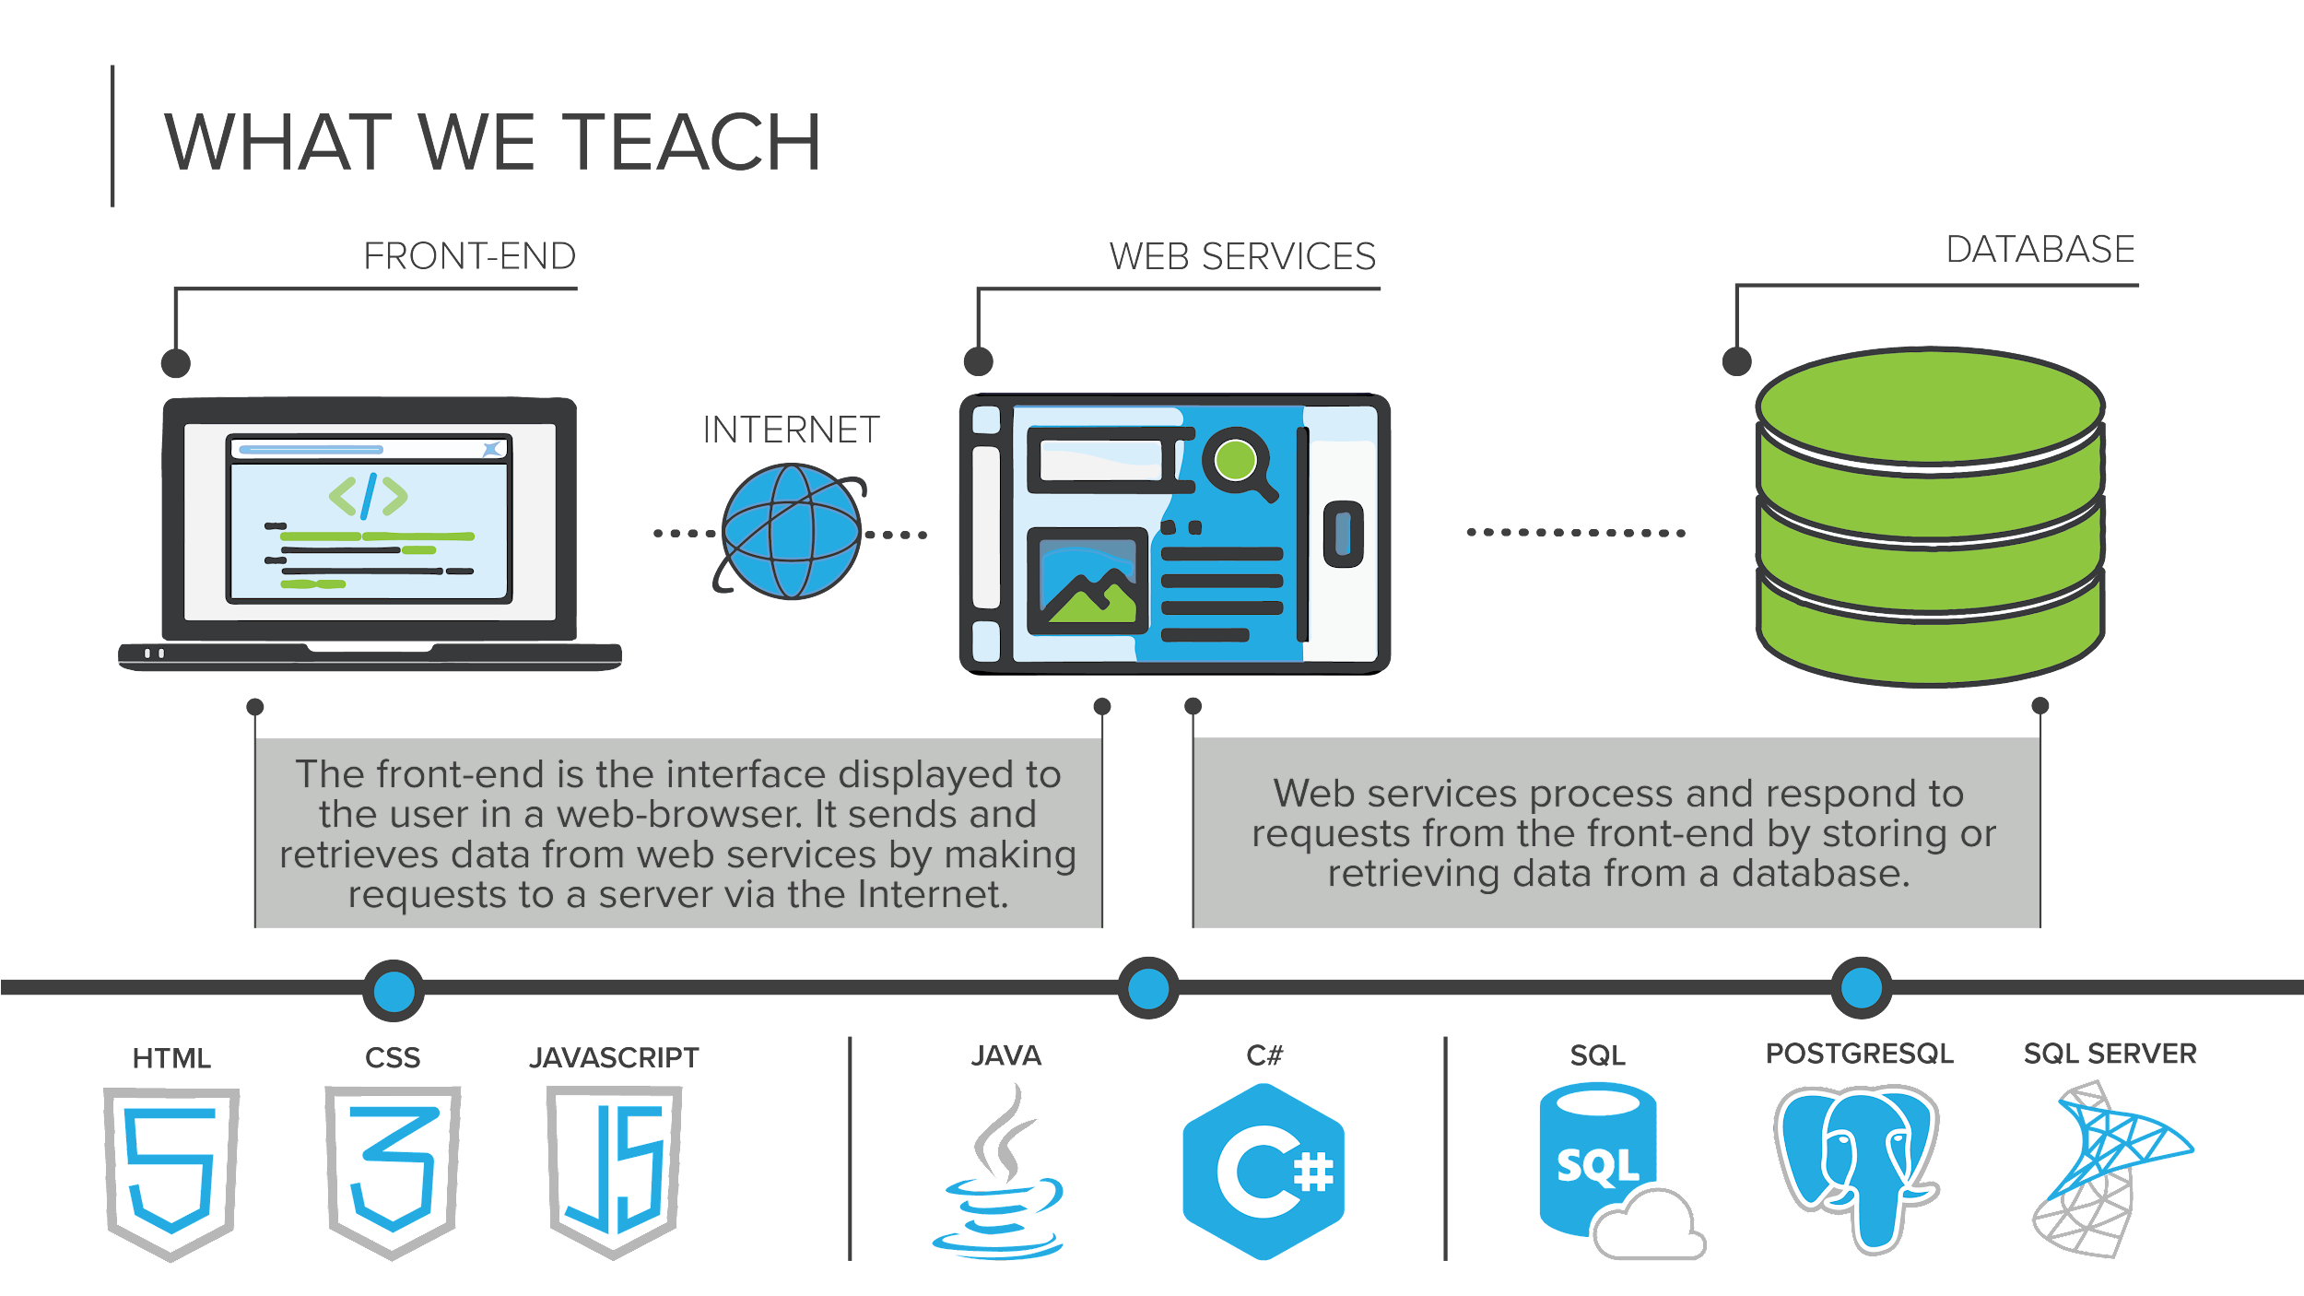

Slide 4







|Program Overview
WEEKS 1-4
WEEKS 5-8
WEEKS 9-12
programming fundamentals
databases and APIs
front-end programming
Learn object-oriented programming to compose larger programs together in Java
Work with development tools like Eclipse, and Git
Store and retrieve data using the Postgres relational databases
Consume and share data from our applications over the Internet using APIs
Develop web application interfaces using HTML, CSS, and JavaScript
Learn how create web components using the Vue.JS JavaScript framework

Slide 5
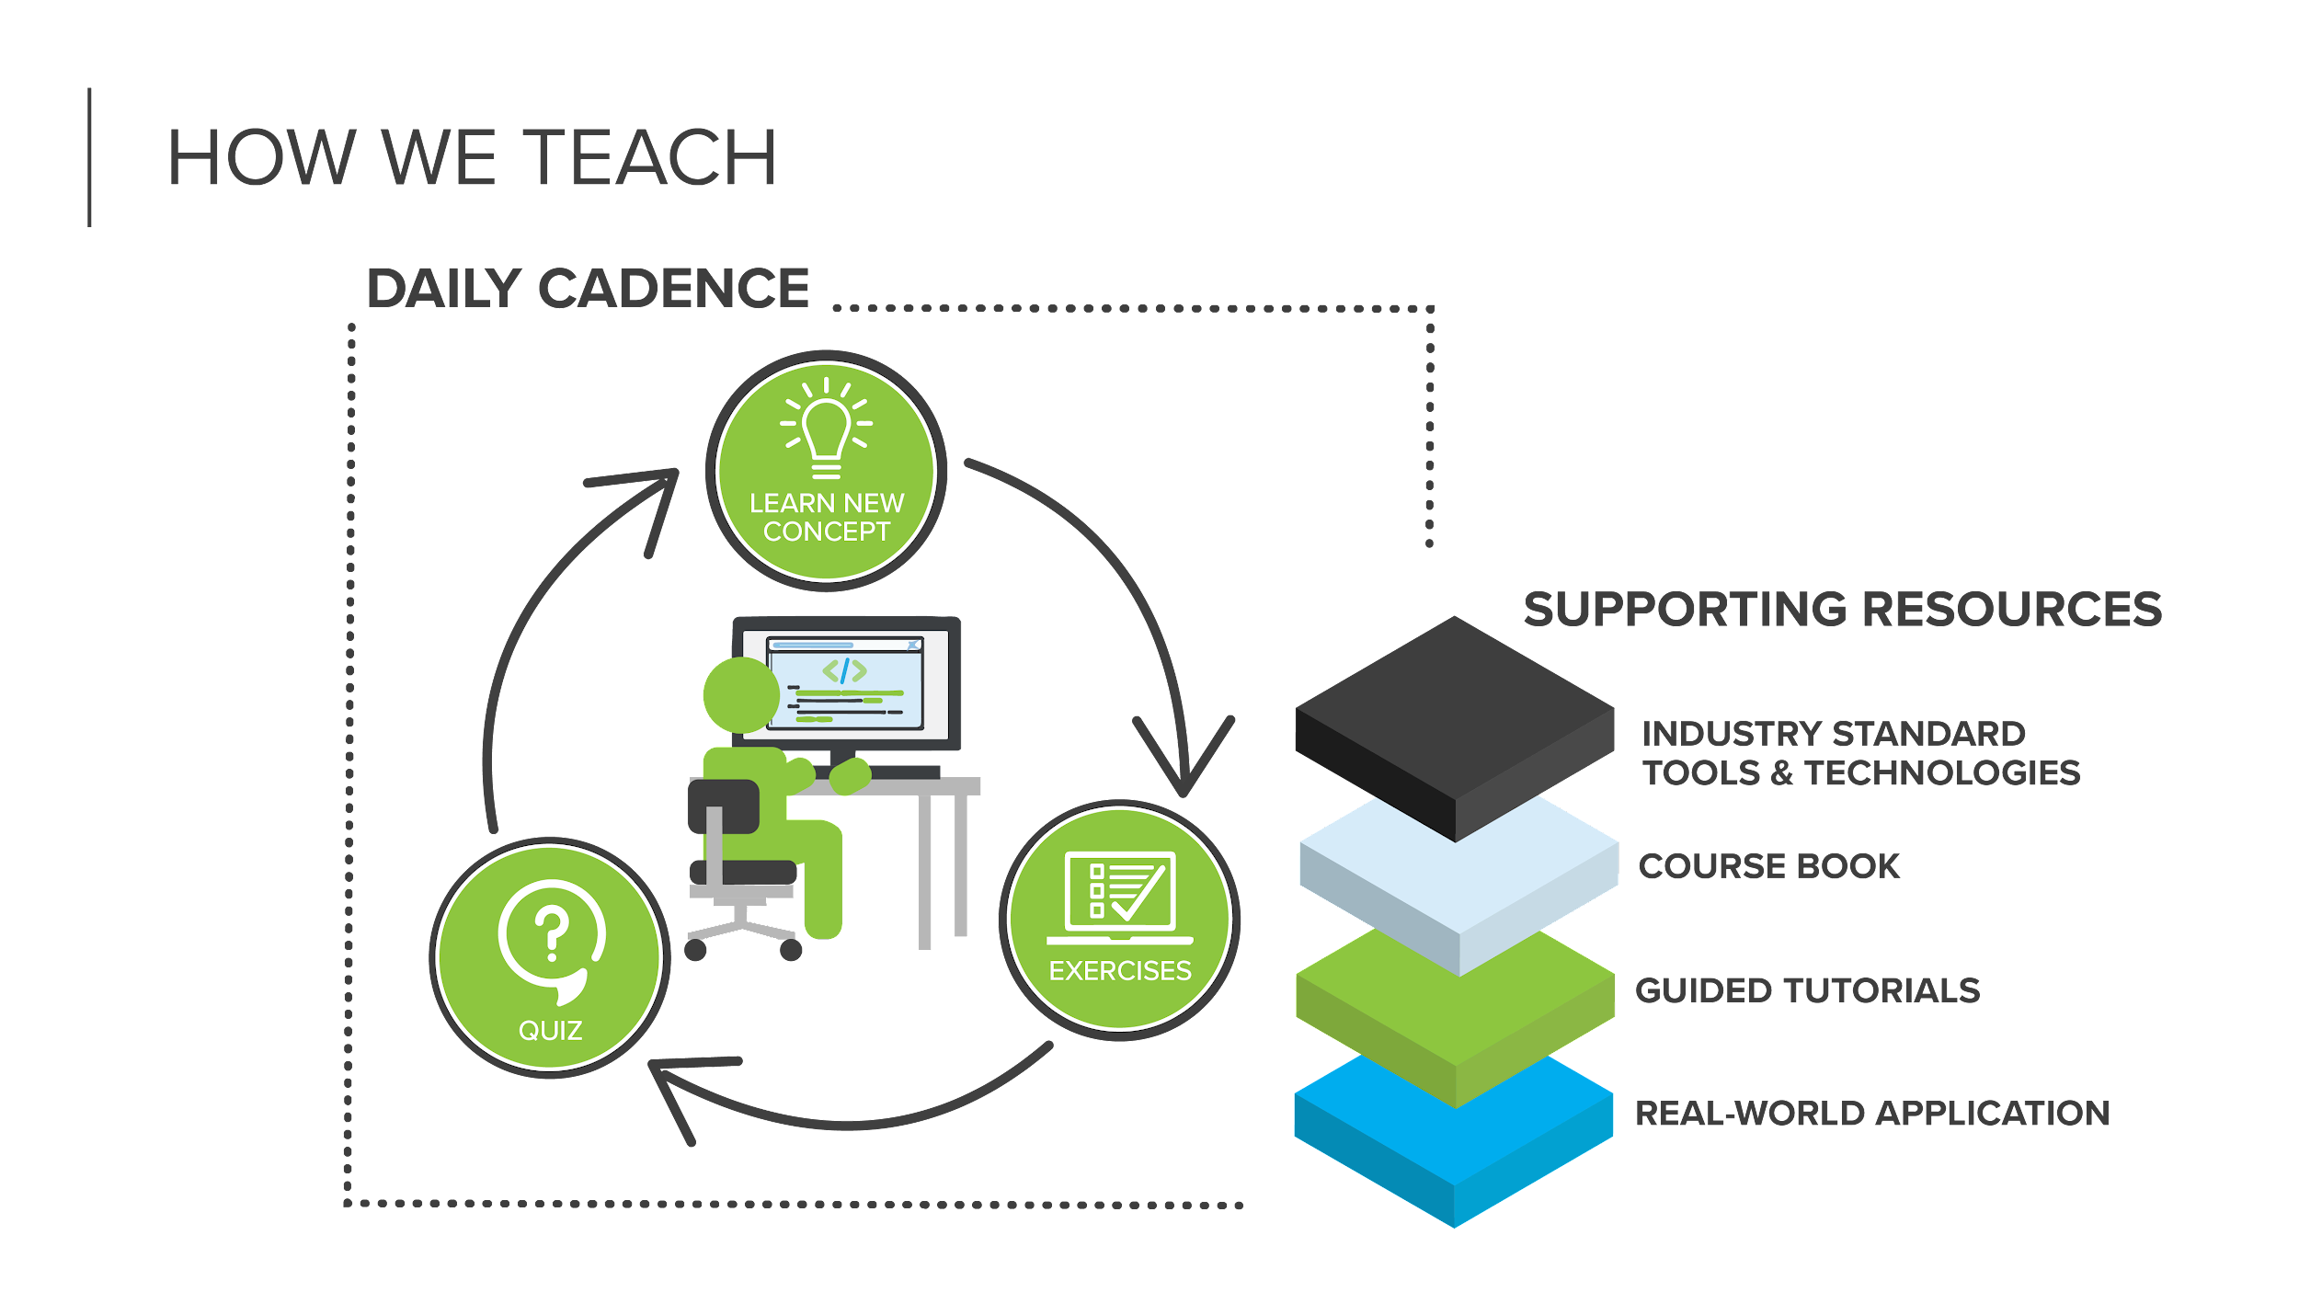

Slide 6
| Syllabus
Kept in the CBUS Campus Calendar.
Each days entry has details, extra links, and other information about the day in the Calendar Entry details.
Each day indicates whether there are individual and/or pair exercises.

Slide 7
| Lecture Structure
Be in the classroom by 9am each morning with Video on.
Daily Pulse Survey
Required
Be honest - I review these daily and try to react to what the class needs, which may include reviewing material, adapting style, or changing the speed of presentation.
Quiz
Lecture
Goes until the material is finished. Usually wraps up between 12 and 1, but not always!
Announcements
I will sometimes call on you for answers during class. I know that is uncomfortable for many people. When you are called on.. it is OK to not know. It is OK to have an opinion. It is OK to wrong. It is OK to ask another student in the class for help.

Slide 8
| Lecture Expectations
Be on time
Video on is required.
Turning your video off will be considered you leaving the room and will count as absent time.
Communicate
If you are going to miss lecture, be late, need to step out, or leave early you must message me and/or Rachelle on Slack as soon as possible.
Interact!
Unmute yourself and just say “I have a question” or “I need some help”
Put it in Chat
Don’t be afraid to speak up!
Message Rachelle.
Give the material your full attention.
While lectures are recorded you can’t rely on them. Sometimes available in an hour, sometimes a day or two, and sometimes things go wrong with the recording.
Be prepared to not always “get it” right away, and understand that is normal and OK.

Slide 9
| Time Expectations
You are expected to treat this like a full time job.
Working hours are Monday through Friday 9am - 5pm.
You are expected to be available during that time
You are also expected to spend whatever time is needed to meet deadlines outside of working hours.
You are expected to be available to and to do work with pair partners
We don’t count the weekend in deadlines, but you are expected to keep up, and that will often include working after working hours and on weekends.
Most students spend 60-80 hours per week during the program.
You are expected to be meet daily deadlines for exercises.

Slide 10
| Exercises
Required to complete the program
Given daily. Some days will be individual, some days will have pair exercises, and some days will have both.
Scored and you must maintain a 2 average throughout the cohort
If you end a module below a 2 average then you will automatically be put on academic probation. If you fail to complete the terms of the academic probation or end a second module below a 2 average, you will be withdrawn from the program.
Turning in something is ALWAYS better than turning in nothing.

Slide 11
3.0 100%-90%
2.0 89% - 50%
“Grading”
1.0 49% - 25%
0.0 24% - 0%
Build errors are an automatic 0.

Slide 12
| DUE DATES
Exercises are distributed daily via Git. You submit them by pushing your code back to BitBucket.
EXERCISES GIVEN... | ARE DUE...
Monday | Wednesday 8 AM
Tuesday | Thursday 8 AM
Wednesday | Friday 8 AM
Thursday | Monday 8 AM
Friday | Tuesday 8 AM
Exercises not turned in by the deadline receive a “0”. Once the exercise is late, the highest score you can receive is a “2”.

Slide 13
| Late Work
Exercises not turned in by the deadline get a zero.
Exercises turned in with build errors are considered late, and will receive a 0 even if otherwise complete.
Once late, an exercise can only earn a “2” (even if it’s > 90% correct and complete)
If you must be late, better to turn in partial exercises (to earn a “1” for >25% complete) so that you can complete it later for a “3”

Slide 14
| Mastery and Understanding
The exercises are focused on mastery of key concepts
Understanding is more important than 100% completion
Turn in your own work, code that you understand
If we suspect that you have turned in code written by others, we reserve the right to meet with you and have you explain the code to us
If you cannot explain how your code works, it will be scored as not having been turned in
The rules for late exercises (maximum score of “2”) will apply to any re-work

Slide 15
| What to do when you are stuck
Student Book
Classmates - it is OK to collaborate, but you must understand the final code.
Check who available or already working together on Sococo and ask them.
Java Green students have green icons and are learning the same material.
For most exercises in module 1 and 3 you can also successfully collaborate with .NET students.
Slack - post in the Java Blue class channel or the main cohort channel
Online resources
Ask an Instructor for help
Don’t be afraid to reach out to instructors from other classes, even the instructors working with .NET - any available member of the instructional staff can help you!
Me, Rachelle, Steve, Kevin, John, Matt
How to find us
Check Sococo for availability
Contact us on Slack

Slide 16
| What should you ask instructors?
Exercises you are stuck on or don’t understand
Different explanation or perspective of a topic
Tutoring on a topic you are struggling with
Review of a topic
Questions you have about your projects
Questions you have about the industry
Any other questions you have
Who should you ask? Any instructor - me, Rachelle, Steve, Kevin, John, Matt, Wesley. Don’t be afraid to tell us you prefer to talk with, you won’t offend us, we understand that different perspectives can be valuable and support that.
Want the perspective of or have questions for a former student? Reach out to Rachelle or Kevin.

Slide 17
| What should you expect when asking?
When you come to an instructor for help with exercises, you can expect
To be asked what you’ve tried
To be asked what resources or tools you’ve used to try to solve the problem
We won’t do the work for you. We will give guidance and hints. If we do end up directing you to code that solves the problem and you don’t understand it - ask us to explain it and make sure you understand before you leave the session.
If you don’t turn in an exercise or get a 1 and didn’t ask for help, expect to be asked why you didn’t seek help.
We sometimes have other commitments. If you ask for help and get told “I have a meeting starting in 2 minutes” - it doesn’t mean we don’t want to help. Either reach out to another instructor or setup a time with us to help.

Slide 18
| Getting help after hours
“Official” Staff hours: Monday-Friday 9am-5pm
Check Sococo to see who may be immediately available
Post a message on the Java Blue Slack channel
Send Me or any other instructor (Rachelle, Steve, Kevin, Matt, John, or Wesley) a direct message on Slack
After hours and on weekends you may not get an immediate answer, but you will get an answer as soon as we are available.
Don’t wait to see us “online and available” on Slack. Send your question regardless of status.
Don’t ever hesitate to contact any of us. You are never bothering us with your questions, and we will only answer when we are available. So even if it is 3am Sunday morning, it’s OK to send a message.
Don’t expect video conferencing after hours. Sometimes we may, but often we will work to solve your problem in Slack.

Slide 19

| Effectively asking for help on Slack
Saying “I can’t make this work, how do I fix it?” doesn’t give enough information to solve your problem. However, “I am getting an error, here is a cut and paste of the error message, and here is a cut and paste of the code causing it. How do I solve this?” provides information to solve the problem.
Message 1: I am trying to fill my bathtub but it is not working, why? Message 2: I am trying to fill the bathtub. The water is running and the drain stopper is in place, but it still won’t fill with water, what can I try?
Message 3: I am trying to fill the bathtub. The water is running and the drain stopper is in place (a picture of it is attached), but it still won’t fill with water, what can I try?

Slide 20
| OTHER THINGS TO EXPECT WEEK 1
While we will review many concepts learned during the prework, we cover a lot of ground.
As stated before, this program can be challenging. Each day can bring with it a good amount of work. Please make sure that you remain caught up and put in the time with each day.
I will conduct “one on one” meetings with each of you to get to know you and better understand any challenges that may make it difficult for you to be successful while you are here.

